Slide 1
CALCULATOR USING GITHUB
TEAM-
1. PRASHANT BHUNAL- HIMACHAL PRADESH
2. RAHUL THAKUR- HIMACHAL PRADESH
3. NAMAN JAIN- DELHI

Slide 2
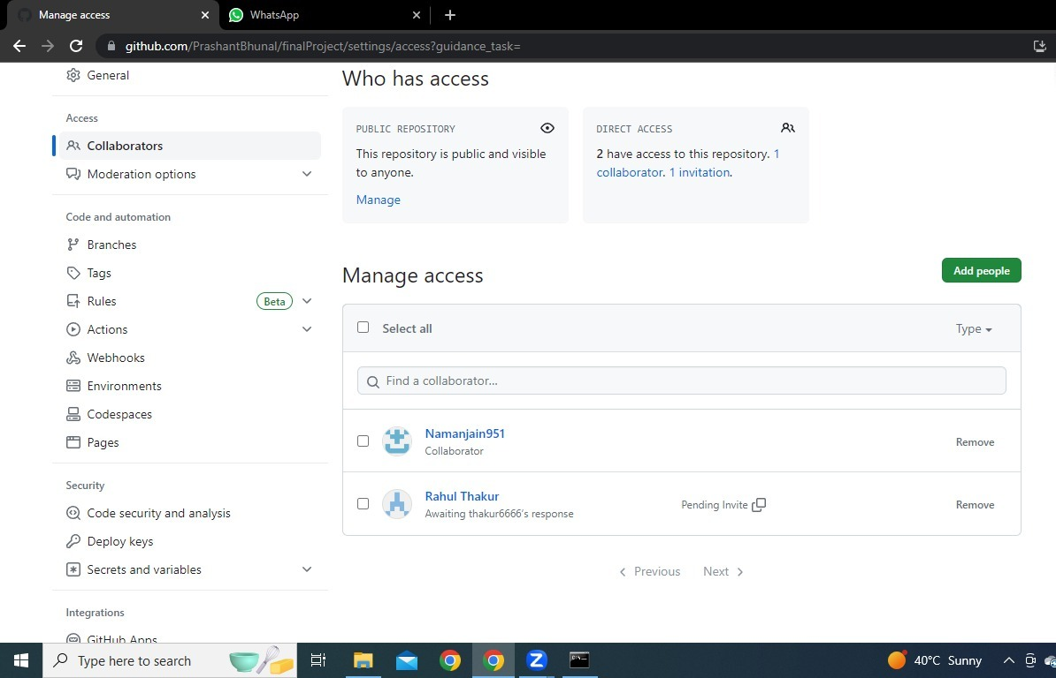
SHARING OF FILES
COLLABORATION FEATURES OF GIT HUB

